Slide 1

UCL Statement on Research Integrity

Slide 2
Code of Conduct
Research integrity statement
Transparency statement

Slide 3
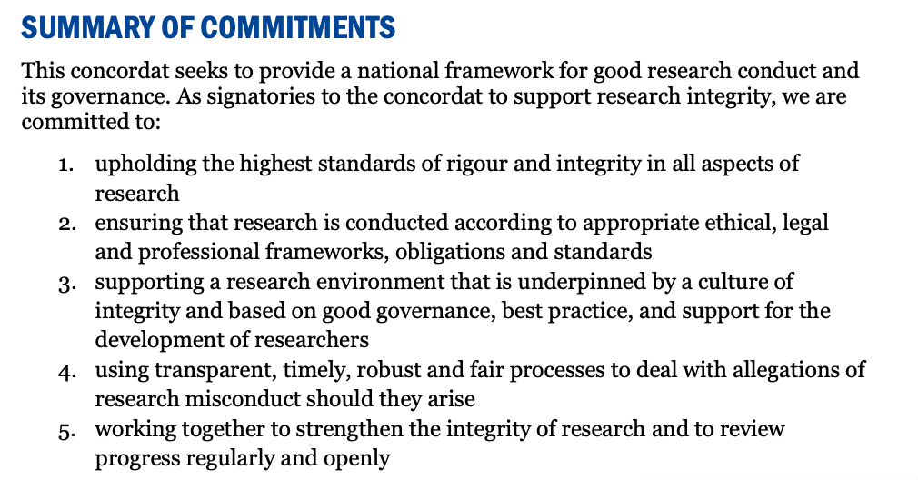
Background
In 2012 Universities UK published the Concordat to Support Research Integrity.
The Concordat was later revised and the current version was published on 25 October 2019.

Slide 4
The Concordat
COMMITMENT 1
The definition of research integrity used in this concordat draws on a number of existing definitions in a way that is applicable to all areas of research. The core elements are:
honesty in all aspects of research, including in the presentation of research goals, intentions and findings; in reporting on research methods and procedures; in gathering data; in using and acknowledging the work of other researchers; and in conveying valid interpretations and making justifiable claims based on research findings
rigour, in line with prevailing disciplinary norms and standards, and in performing research and using appropriate methods; in adhering to an agreed protocol where appropriate; in drawing interpretations and conclusions from the research; and in communicating the results
transparency and open communication in declaring potential competing interests; in the reporting of research data collection methods; in the analysis and interpretation of data; in making research findings widely available, which includes publishing or otherwise sharing negative or null results to recognise their value as part of the research process; and in presenting the work to other researchers and to the public
care and respect for all participants in research, and for the subjects, users and beneficiaries of research, including humans, animals, the environment and cultural objects. Those engaged with research must also show care and respect for the integrity of the research record
accountability of funders, employers and researchers to collectively create a research environment in which individuals and organisations are empowered and enabled to own the research process. Those engaged with research must also ensure that individuals and organisations are held to account when behaviour falls short of the standards set by this concordat

Slide 5
At UCL
UCL’s Research Strategy emphasises a commitment to research integrity, including a commitment to open research.
Standards expected by all those involved with research at or in collaboration with UCL: adherence to the Code of Conduct for Research and the principles of integrity set out in the UCL Statement on Research Integrity

Slide 6
Code of Conduct
The UCL code of conduct in research covers five main areas:
professional and personal integrity of researchers
process of research design
publication process
leadership responsibilities
institutional responsibilities

Slide 7
Code of Conduct
Professional and personal integrity of researchers Researchers should meet the standards expected by funding bodies, their profession and the institution. They should be:
honest at all stages of the research process, from applying for funding to publishing results and acknowledging the work of others;
open and willing to discuss results and share data with colleagues;
aware of and adhere to legal and ethical requirements relevant to the area of research;
ready to participate in (i) training to improve their own skills and (ii) the mentoring of others;
alert to perceived or actual conflicts of interest and address these as appropriate – in accordance with the UCL declaration of interest policy;
aware of the types of research misconduct outlined in the UCL policy and procedure for investigating and resolving allegations of misconduct in academic research.
Research design and methodology
The following requirements apply to research in all disciplines:
clear documentation for the rationale for the study and any subsequent modifications should be kept in files or notebooks;

Slide 8
Statement on Research Integrity
“UCL is committed to ensuring the highest standards of integrity in all aspects of its research activities and expects that all those involved with research at UCL maintain a similar commitment. These high standards are essential not only for ensuring the highest quality of research, but through this, the continued trust and confidence of other researchers and the public in research, individual researchers, UCL as an institution and the research community as a whole.“
Includes principles of Commitment 1 of the Concordat and
Reference to Transparency Statement

Slide 9
Transparency Statement
Open Research Making research open is a core part of research transparency, and open research practices are rewarded in promotion decisions. We recognise that there is significant variation across disciplines, influencing how appropriate open research practices may be. With this in mind, as far as is possible and appropriate, we expect researchers to:
make their research methods, software, outputs and data open, and available at the earliest possible point, according to statements such as the Berlin Declaration
describe their data according to FAIR Data Principles, ensuring that it is Findable, Accessible, Interoperable and Reusable
deposit their outputs in open access repositories:
publications in repositories such as preprint servers, and UCL Discovery via Research Publications Service
research data in repositories such as the UCL Research Data Repository or the UK Data Archive. Where subject-specific repositories are used, we recommend using repositories that meet Nature Scientific Data’s trusted repository criteria, such as these recommended repositories
software in suitable repositories, for example GitHub and Zenodo.

Slide 10
Transparency Statement
Reproducibility The reproducibility of both research methods and research results (see Annex for definitions) is critical to research in certain contexts, particularly in the experimental sciences with a quantitative focus. Reproducibility forms part of UCL’s wider commitment to transparency and rigour in all of our research. We recognise that behaviours in support of transparency and rigour vary considerably across disciplines and methodologies, and encourage our researchers to adopt actions most appropriate to their disciplines. In the arts, humanities and social sciences, it may be more useful to refer to transparency or academic rigour in the use of research methods and in the whole research process – from the collection of evidence or thoughts through analysis to final conclusions and the publication of findings. The reproducibility of research methods is required for research to be replicated (see Annex). This, in turn, is essential in research contexts where findings must be robust and reproducible in order to form a solid foundation on which to build further knowledge. In research contexts where reproducibility is possible and appropriate, we strongly encourage researchers to use measures that support it. These include (but are not limited to):
pre-registration of study procedures and analysis plans, and use of registered reports³ where appropriate
transparent reporting of research in line with recognised community guidelines⁴
disclosure of all tested conditions, analysed measures and results
transparency around statistical methods (including sample size planning and statistical assumptions and pitfalls)
use of preprints
carrying out replication studies
publication of “null” findings.

Slide 11
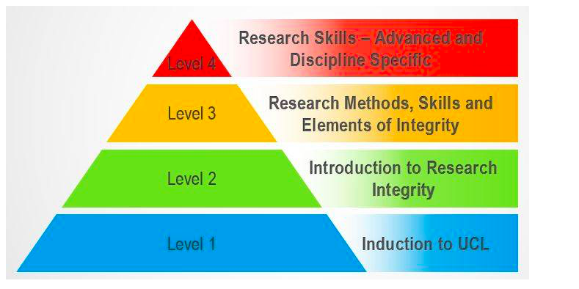
Research Integrity Training Framework
https://www.ucl.ac.uk/research/integrity/research-integrity-training-framework

